Slide 1
Employee Analysis
Danny Chang

Slide 2
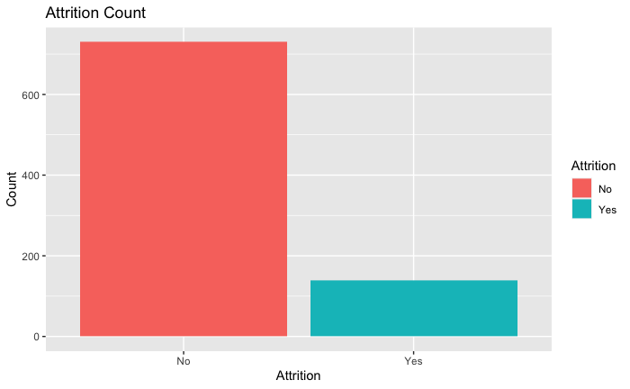
Attrition Count
Attrition “No”: ~750
Attrition “Yes”: ~ 160
Almost 7:1 ratio

Slide 3
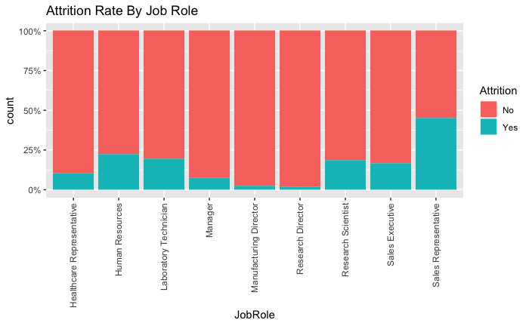
Attrition By Job Role
Sales Rep. : 50%
Human Resources: ~25%

Slide 4
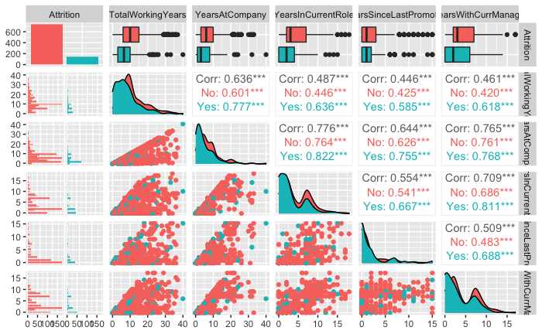
Attrition: Predictor Variable Candidates
Attrition has some differences in distribution of variables related to length of time
Most are correlated

Slide 5
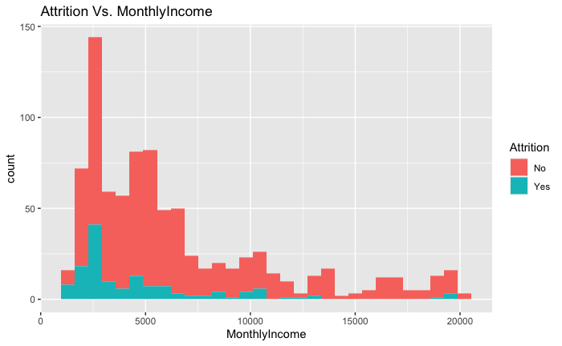
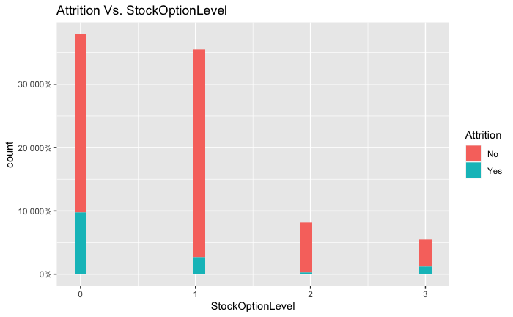
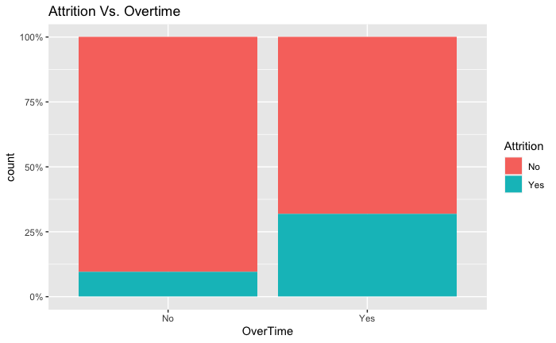
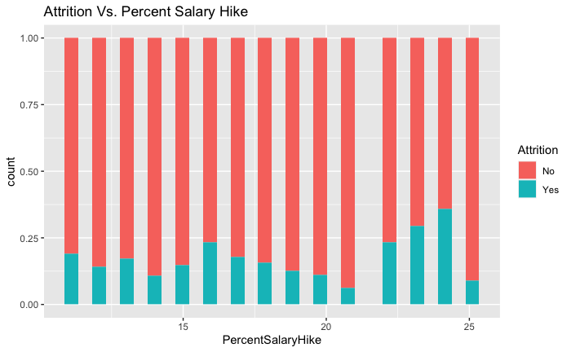
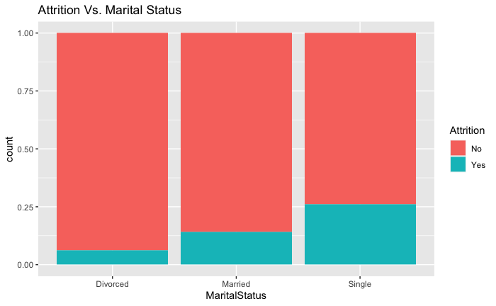
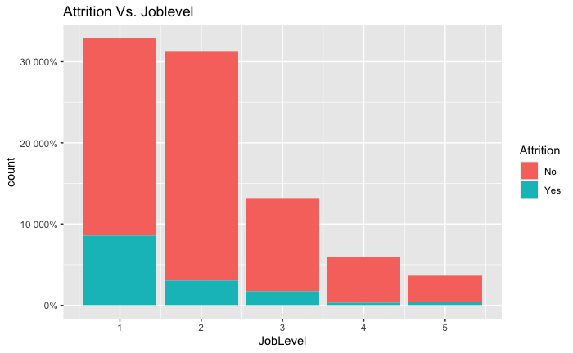
Attrition: Predictor Variable Candidates

Slide 6
3 Most Important Variables For Predicting Attrition
Job Role
Monthly Income
Overtime

Slide 7
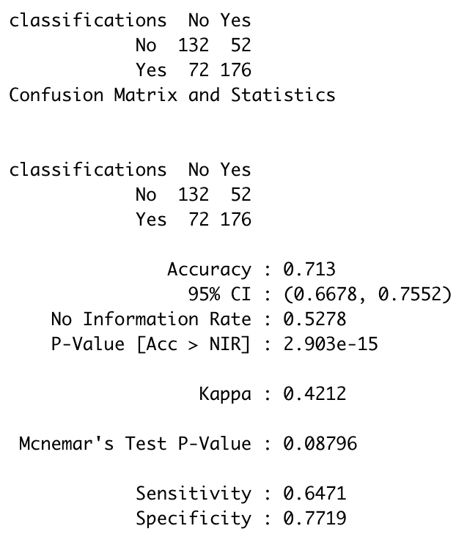
KNN Model for Attrition Prediction
My KNN Model is pretty bad.
Accuracy: .713
Sensitivity: .6471
Specificity: .7719
We will not use this model

Slide 8
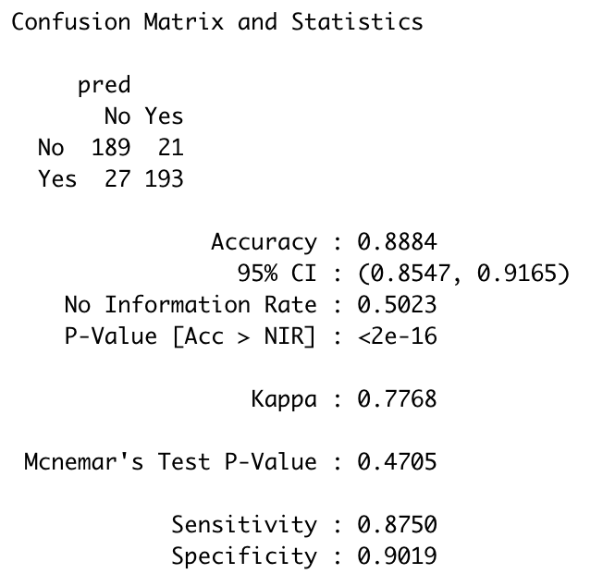
Naive-Bayes Model for Attrition Prediction
My Naive-Bayes Model is much better.
Accuracy: .8884
Specificity: .9019
Sensitivity: .8750

Slide 9
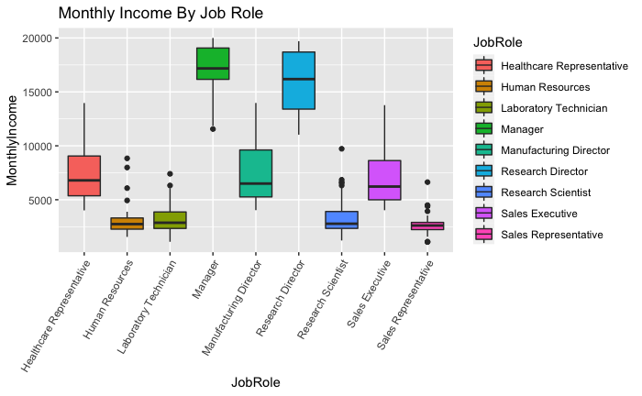
Monthly Income By Job Role
Income is heavily related to Job Role
Least $: HR and Sales Rep
Most $: Manager and Research Director

Slide 10
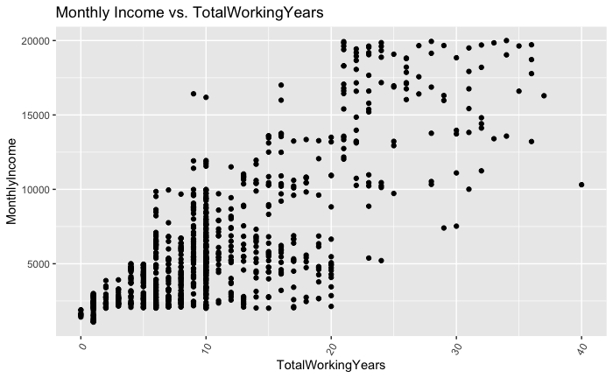
Monthly Income By Total Working Years

Slide 11
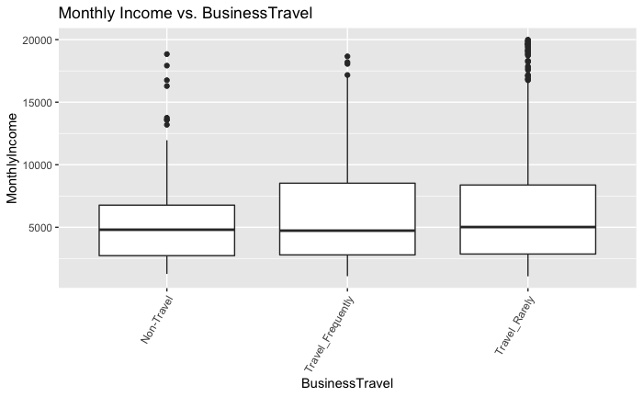
Monthly Income By Business Travel

Slide 12
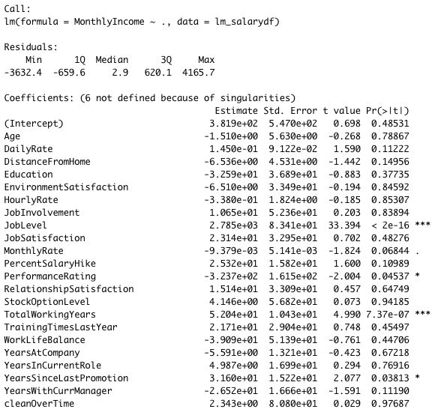
Other Monthly Income(Salary) Candidates
lm(formula = MonthlyIncome ~ ., data = lm_salarydf)
Numeric Variables with linear relationship/significance
JobLevel, PerformanceRating,TotalWorkingYears, YearsSinceLastPromotion

Slide 13
Salary Prediction
Interested Variables:
Categorical: Job Role, Business Travel
Numeric: JobLevel, PerformanceRating,TotalWorkingYears, YearsSinceLastPromotion
RMSE: 1042.313

Slide 14
Thank you!

Slide 15
Video Link
https://drive.google.com/file/d/1srzTIJI2Ow2vudsjGM2-xGMUC6uKXKr_/view?usp=sharing

